Slide 1


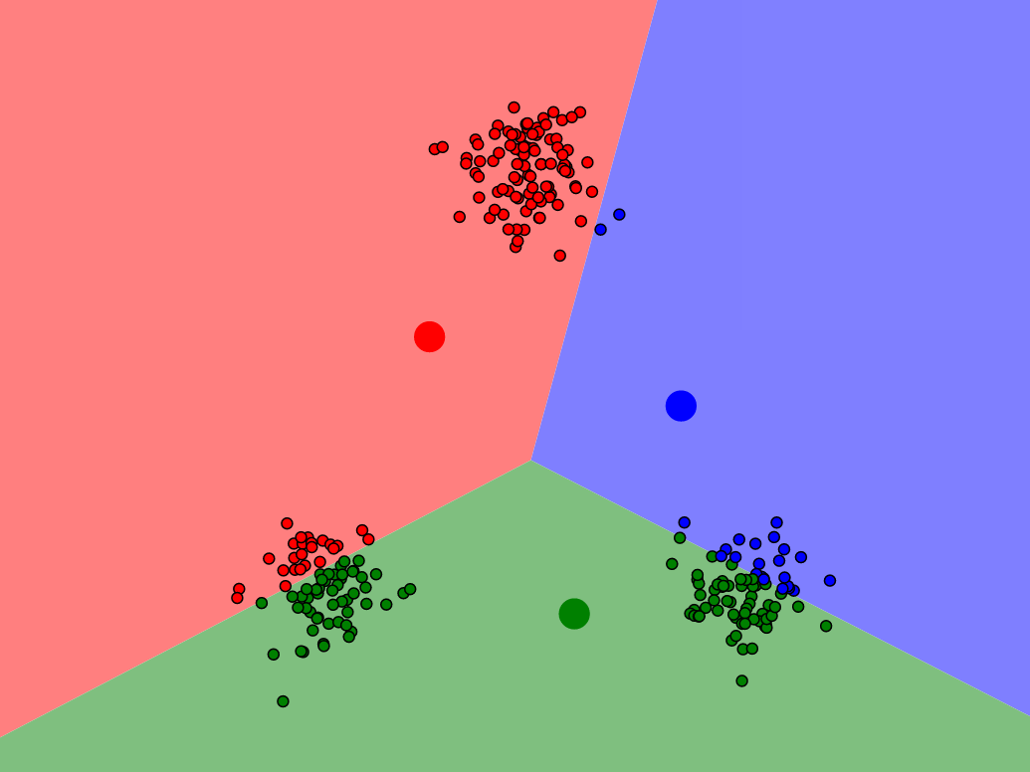
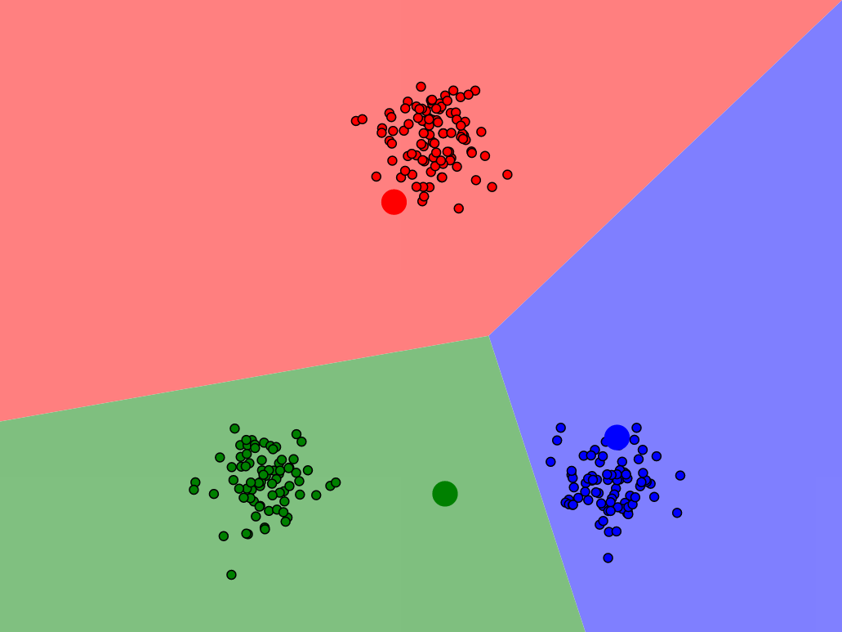
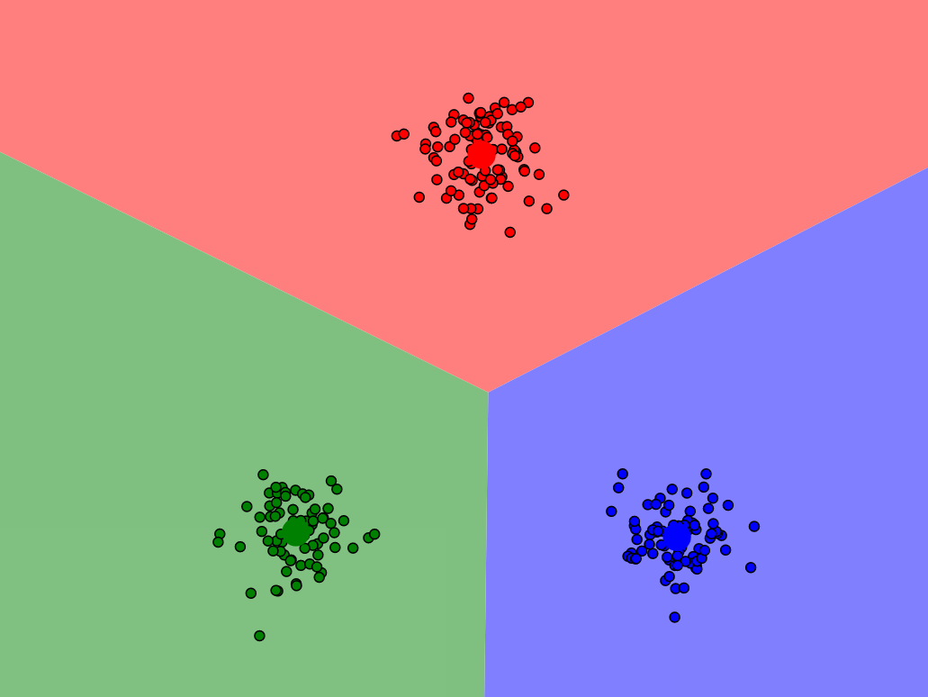
K-means Clustering
Mehmet Emre Özyurt
Supervisor: Fatemeh Farokmanesh
28.06.2021
(1)
(2)
(3)
(Harris, 2014, Visualizing K-means)
1

Slide 2
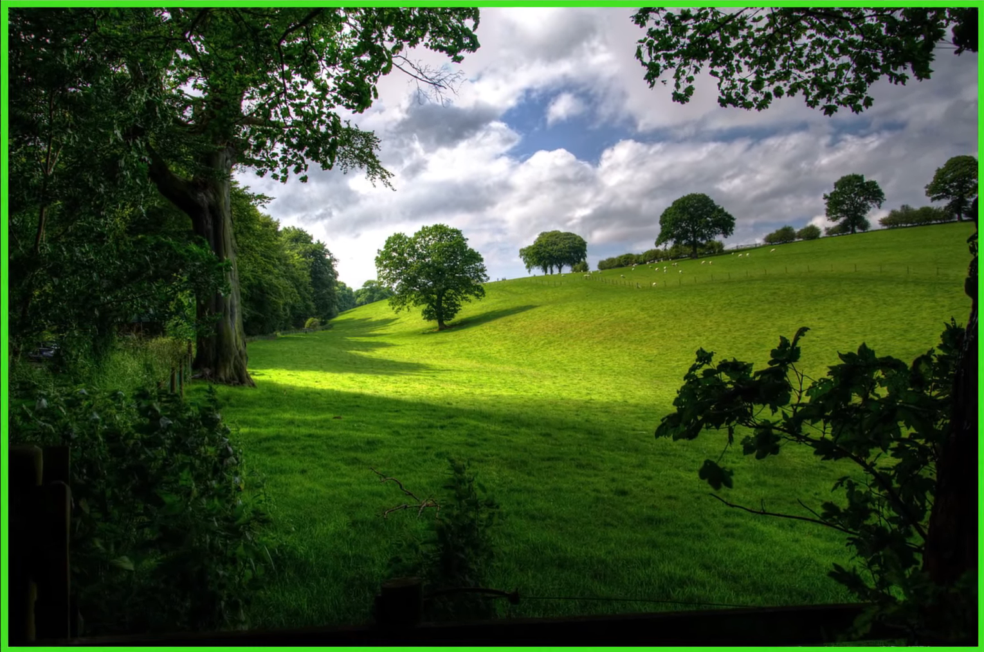
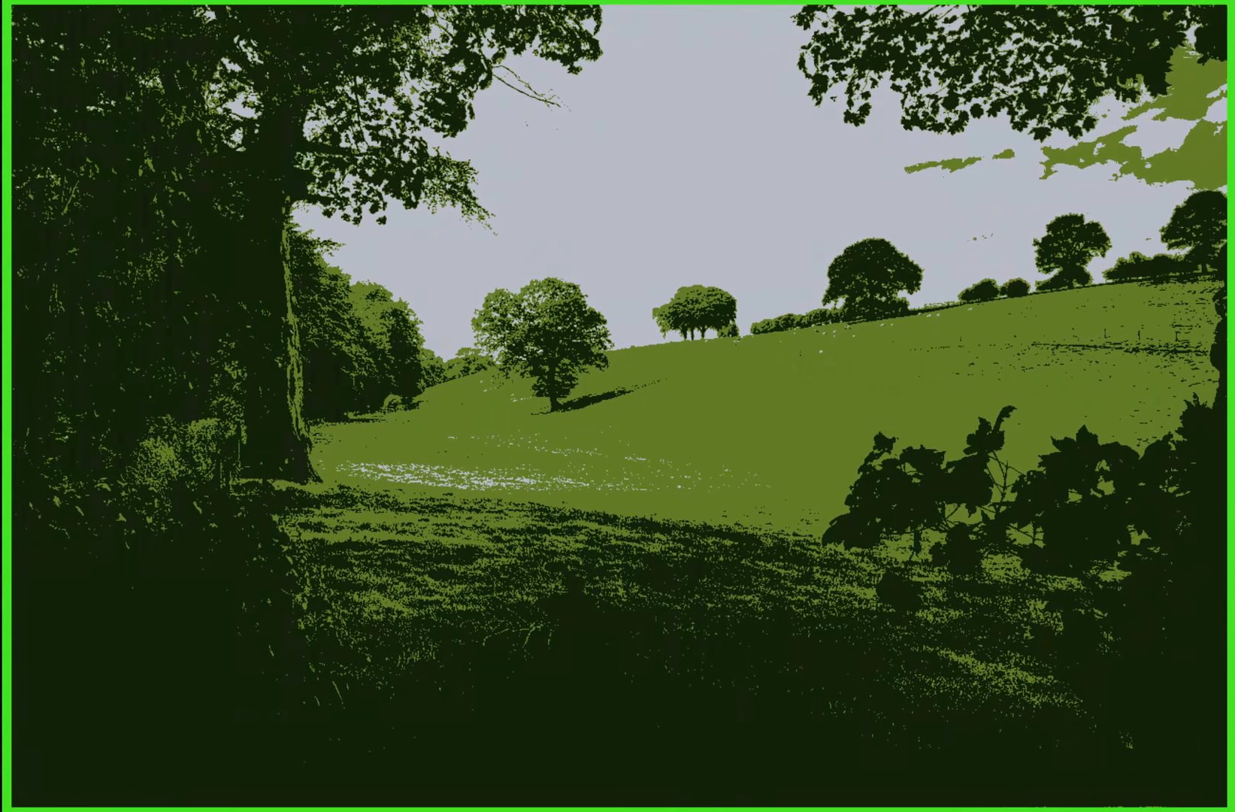
Motivation and Data Visualization
Internal structure of the data
Labeling and highlighting similarities
Transform big data into meaningful substance
Various applications
Image compression
Medical diagnosis
Human behavior
2

Slide 3
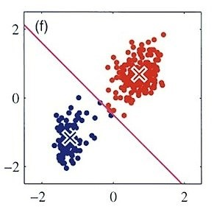
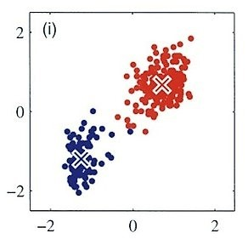
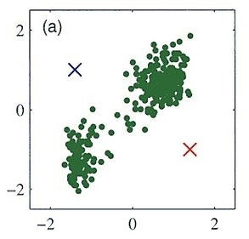
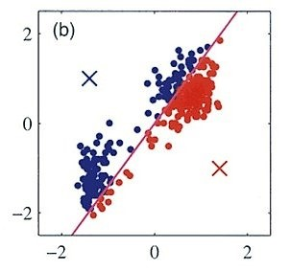
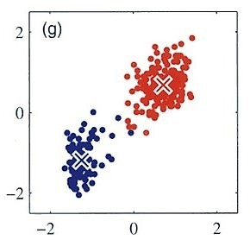
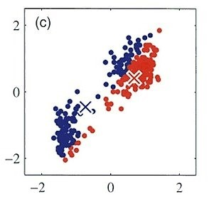
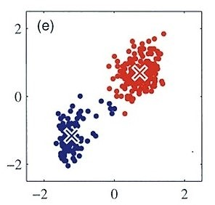
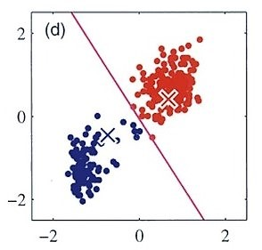
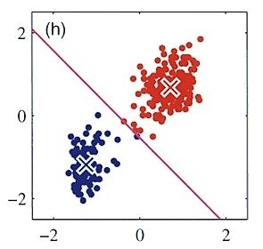
Conventional K-means Algorithm
Partitional and unsupervised clustering method
1. Determine the number of clusters
2. Choose K starting points (initial means)
3. Assign each point to the closest mean
4. Calculate the new mean of each cluster
5. Repeat step 3 and 4
6. If any clusters have changed, repeat step 5
If not the process is done.
(Bishop, 2006)
3

Slide 4
Proximity measures
Which cluster does a data point belong to?
Euclidean Distance
Problems with scales
Manhattan Distance, Mahalanobis distance
Measuring preference
Quality of Clustering?
4

Slide 5
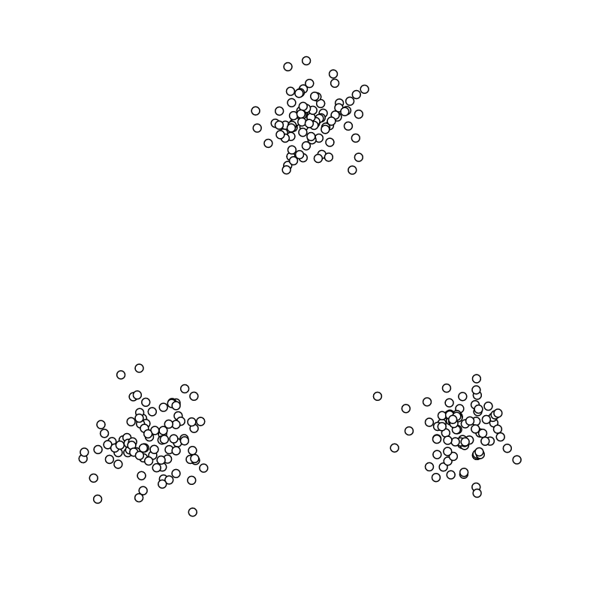
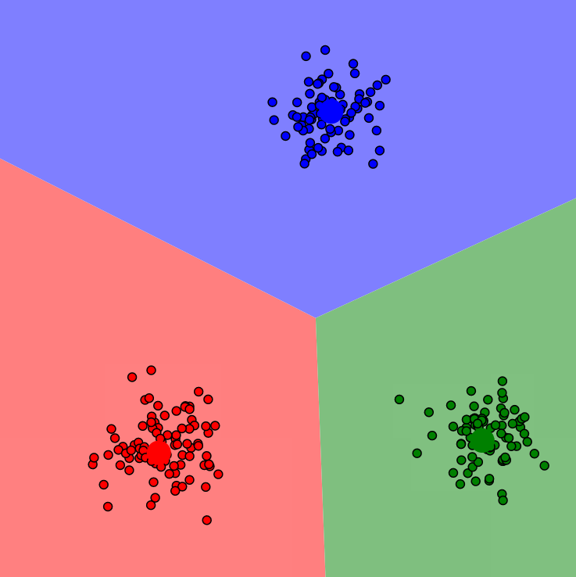
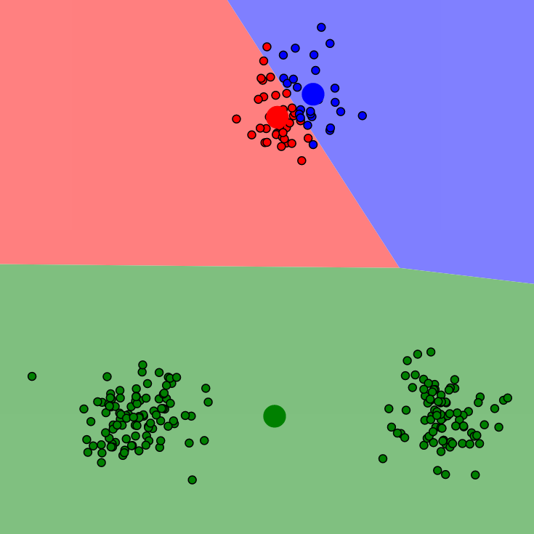
Quality of Clustering
What constitutes a good cluster?
Ideal clustering
Poor clustering
(Harris, 2014, Visualizing K-means)
5

Slide 6
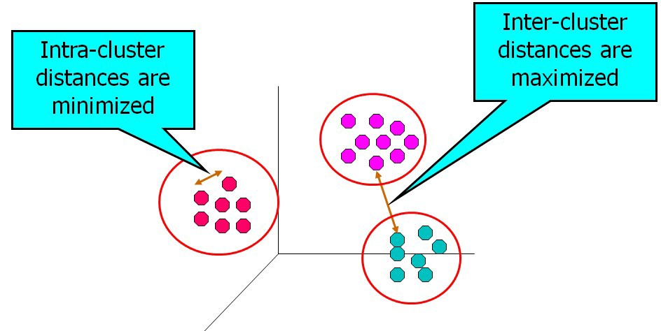
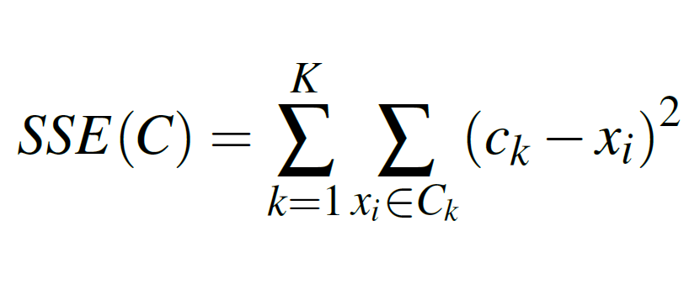
Quality of Clustering
High intra-cluster similarity
Low inter-cluster similarity
Dense & Seperated
Sum of squared Errors (SSE)
(Singh, 2018)
K-means clustering as an optimization problem
6

Slide 7
Initialization methods
1- Random initialization
Simple and widely used
Highly volatile and inconsistent
Different results for the same data
Poor distribution of means -> sub-optimal clusters
Trial-and-error. Choose the best result
7

Slide 8
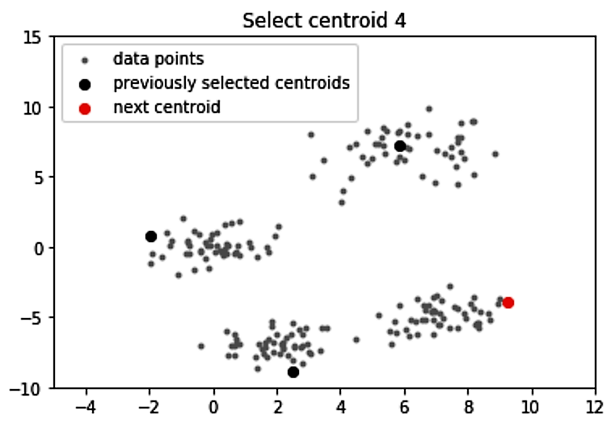
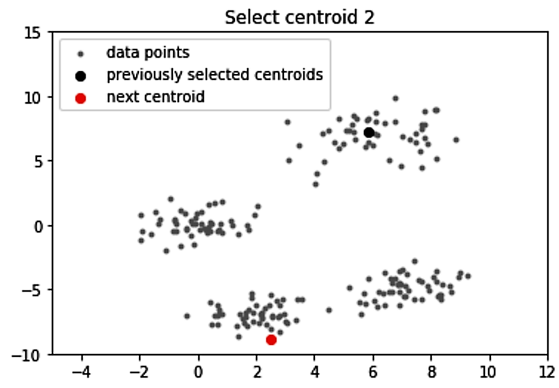
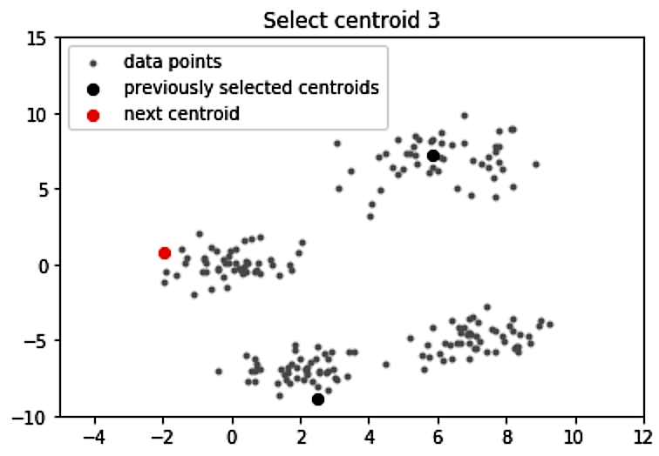
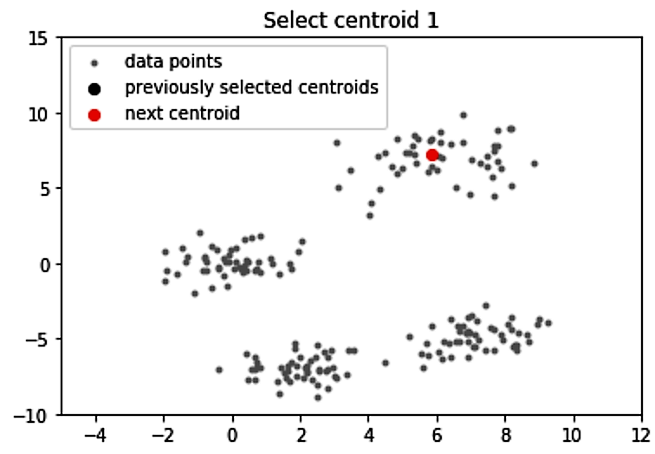
Initialization methods
2- K-means++
Close starting points => cramped clusters
Unbalanced distribution
Points that are furthest from each other
First mean as random
(Khosla, 2020, K-means++)
Following means based on a weighted probability distribution
Proportional to the distance from x to the closest mean
More time at the start but total runtime better than random initialization. Balanced distribution = faster cluster forming
8

Slide 9
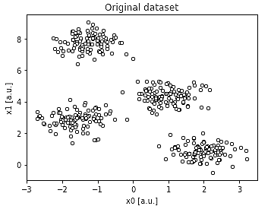
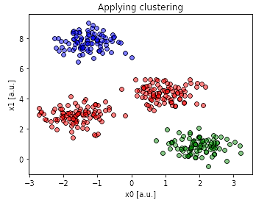
Selecting number of clusters K
(Oleg Zero, 2019)
Run the algorithm with different K values
Identify the optimal K based on different metrics
9

Slide 10
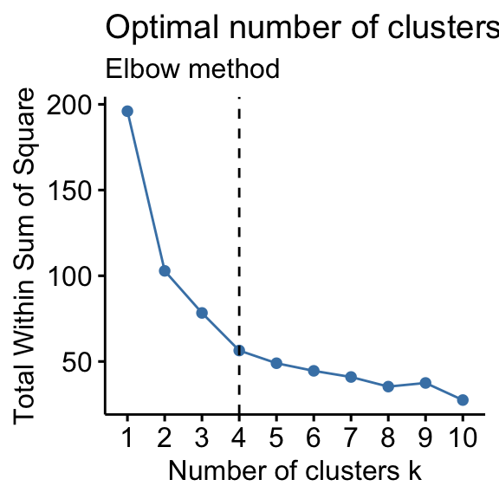
Selecting number of clusters K
1- The Elbow Method
Total intra-cluster distance per K
A bend in the graph
Reduction in variance
Increasing K reduces the variance very slightly
Non-optimal to form an additional cluster
Not ideal if the data is not distinctly clustered
(Kassambra, 2017)
10

Slide 11
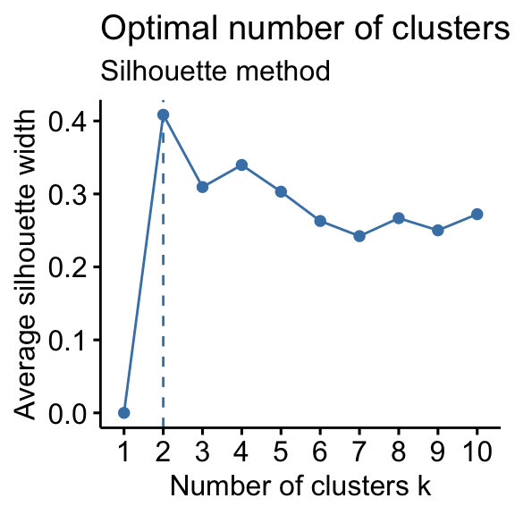
Selecting number of clusters K
2- The Silhouette Method
How similar is a point to its own cluster compared to other clusters?
The average distance of point i to all points in the same cluster = a(i).
The average distance of point i to all points in other clusters = b(i).
b(i) - a(i)
The silhouette value s(i) =
max(a(i), b(i))
High silhouette value is desirable
Observe the average silhouette value per K
Optimal Clustering when Global Maximum
(Kassambra, 2017)
11

Slide 12
Advantages vs. Disadvantages
+ Ease of implementation and modification
+ Fairly efficient
- But requires parameter tuning to determine K
- Non-deterministic
+ Relatively fast
+ Scales well to large data sets
12

Slide 13
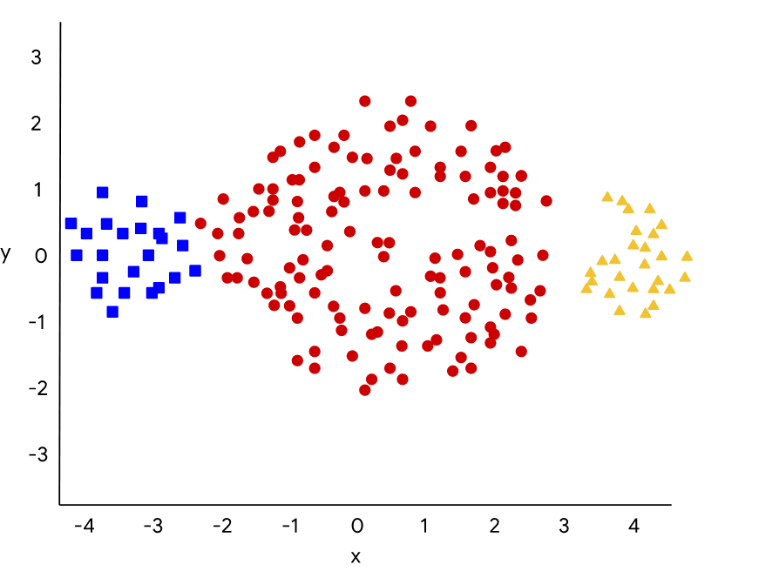
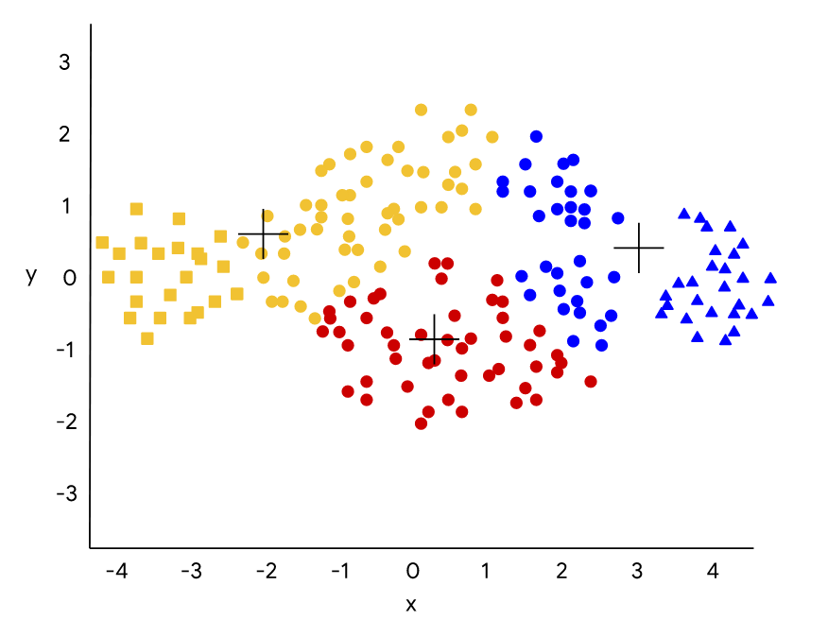
Advantages vs. Disadvantages
+/- K-means assumes clusters are spherical and equally sized
- Outliers
https://developers.google.com/machine-learning/clustering/algorithm/advantages-disadvantages)
13

Slide 14



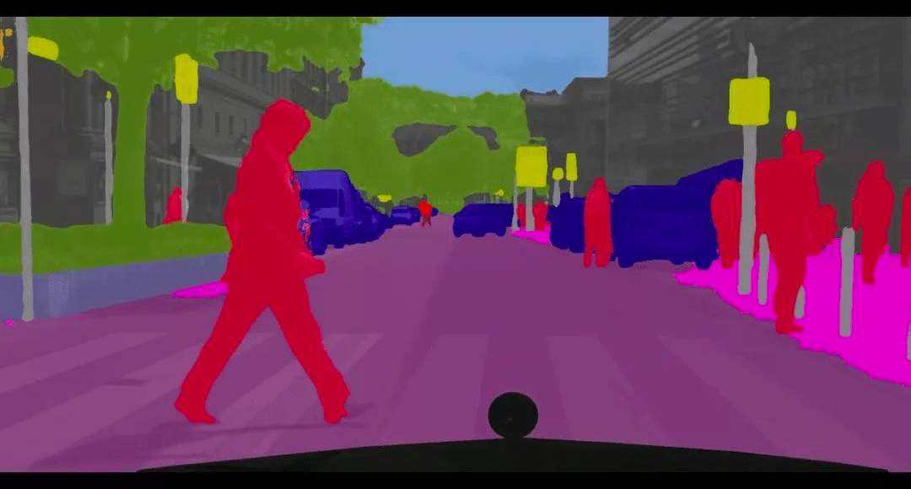
Applications of K-means Clustering
1- Image Compression
RGB image. 3 color channels red, green and blue
Each data point has 3 color values
Limit the color values of each data point
Cluster the data into k dominant colors
Image segmentation
(Created on MATLAB)
14

Slide 15
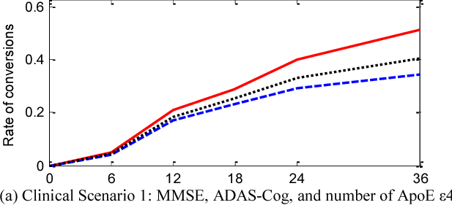
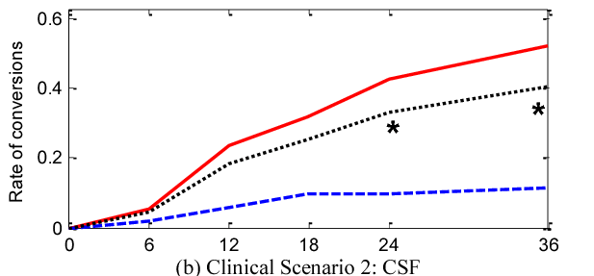
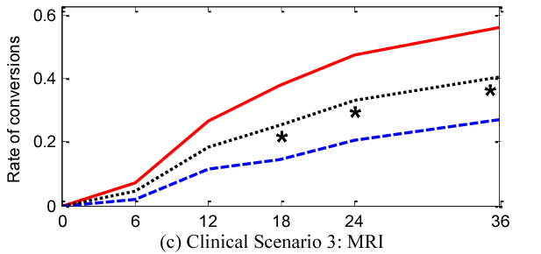
Applications of K-means Clustering
2- Medical diagnosis
Blood samples, MRI, neurological data
Cognitively normal -> Mild cognitive Impairment
Alzheimer's Disease
Define clinical scenarios
Likelihood of transition
Early diagnosis and treatment
Not only biological, but also social diagnosis
(Escudero,Zajicek,Ifeachor, 2011)
15

Slide 16
Conclusion
Main Algorithm
Quality of Clustering
Factors that affect the quality
Initialization Methods
Determining number of Clusters
Strengths and weaknesses
Applications
Image compression
Medical diagnosis
Widely used in data visualization since 1970s
General understanding required to improve
Insights to data interpretation
16

